Slide 1
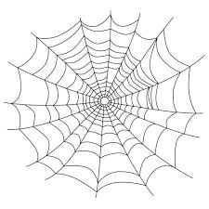
4 for 4 Recipe Page Group Name: 4 The Web
Doudou Sy Gueye (Leader, Designer and Programmer)
Benjamin Pham (Designer and Programmer)
Hyejin Shin (Designer and Programmer)
Nirmal Thani (Designer and Programmer)

Slide 2

User Statement
The User wants a clean page for recipe that is eye-catching and very interactive but cannot find one.
Our pages gives an interactive Recipe Page for the user that will provide them with awesome recipes in an attractive way

Slide 3
Overall Web design
Easy to navigate design for users
Algorithm and structure of HTML and CSS correspond to section of web page
Color design is light and simple
Simple diagrams and transitions for recipes

Slide 4
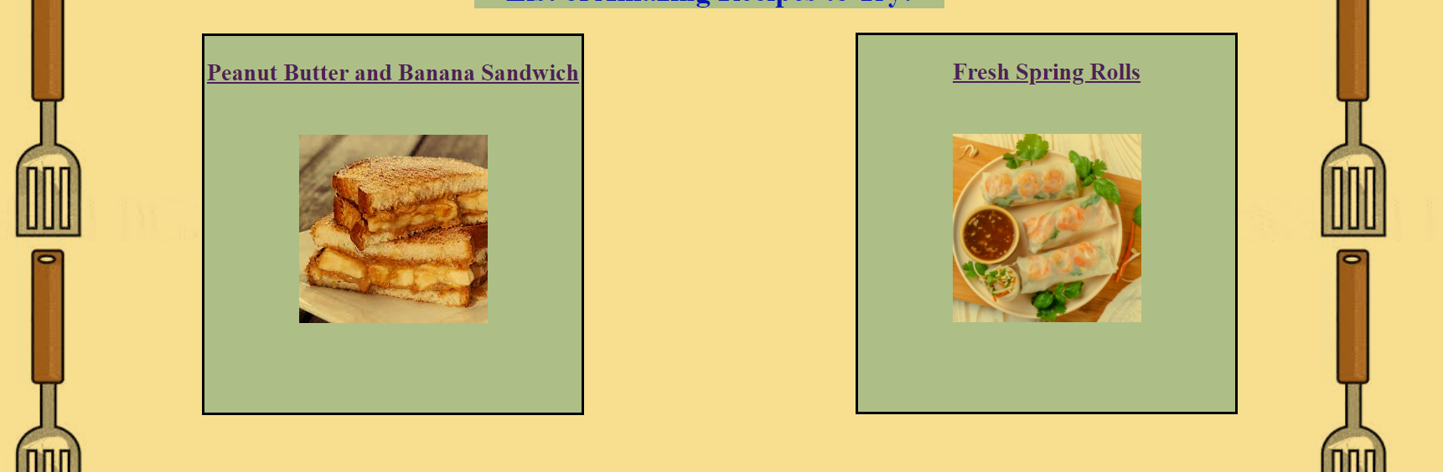
Home Page
Color: White, Background: Spatula
Separate Recipes in sections which are clickable
Divided the section in divs

Slide 5
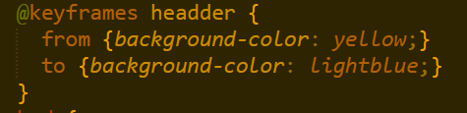
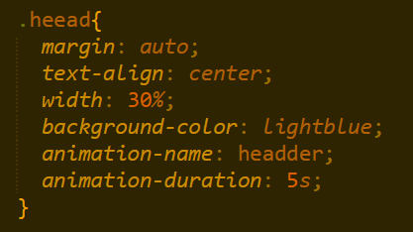

Header
Background color changes as you enter the page
This was done using animation

Slide 6
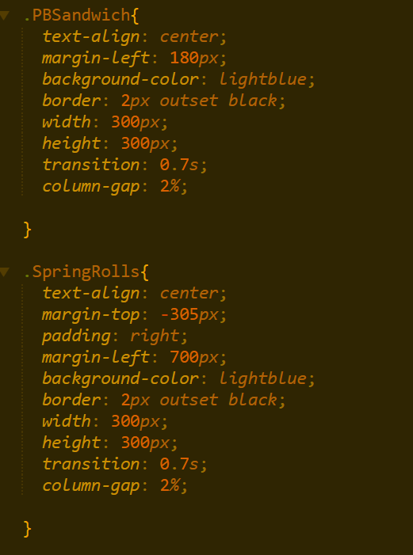
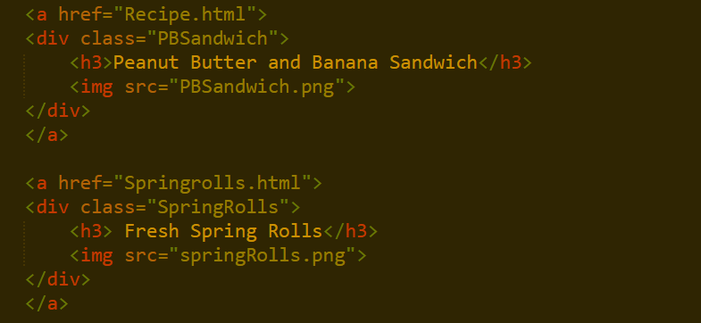
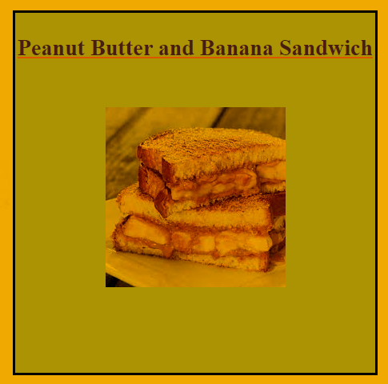
The Recipe Blocks
These were done using divs
The user can hover over the blocks
The user can click on each block to get sent to the recipe pages

Slide 7
Design – Peanut Butter and Banana Sandwich
Background Color: Light Yellow
Text Color: Brown
Hover Color: Orange
Everything is put in sections or divs and divided across the page

Slide 8
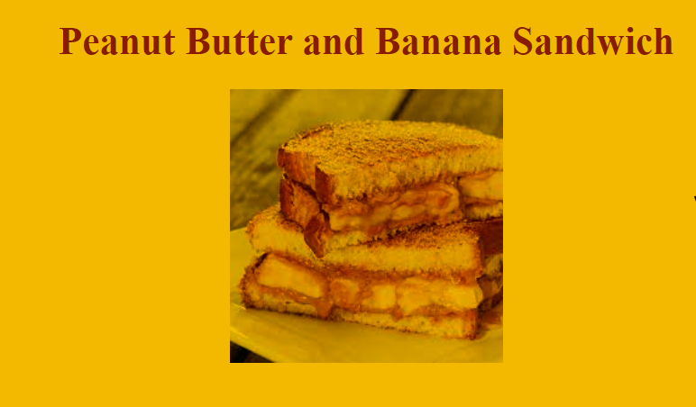
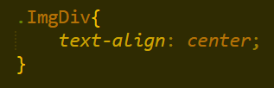
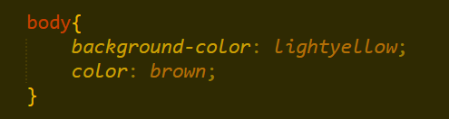
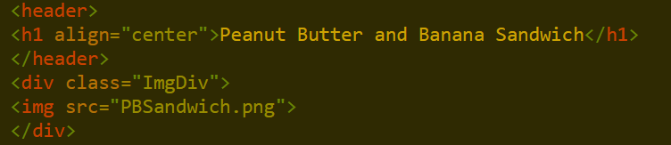
Header
Header is centered and include the Recipe Title and the picture
The text color is brown

Slide 9
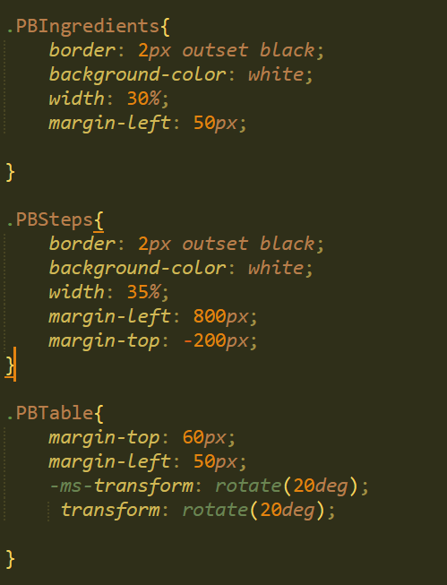
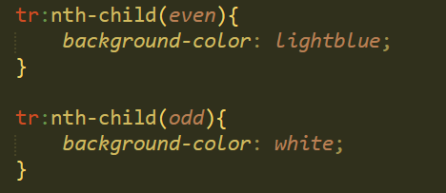
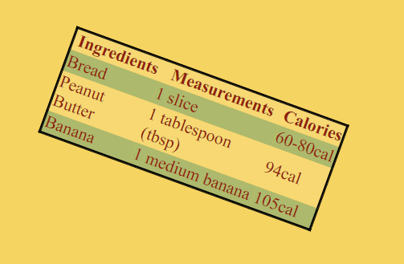
Containers (divs)
The different sections are separated into divs
They each have a border
One div is a table and uses the nth-child() to set colors to the different lines
Transform was used on two of the divs to make them rotate
Hover over links is used and changes colors to Orange

Slide 10
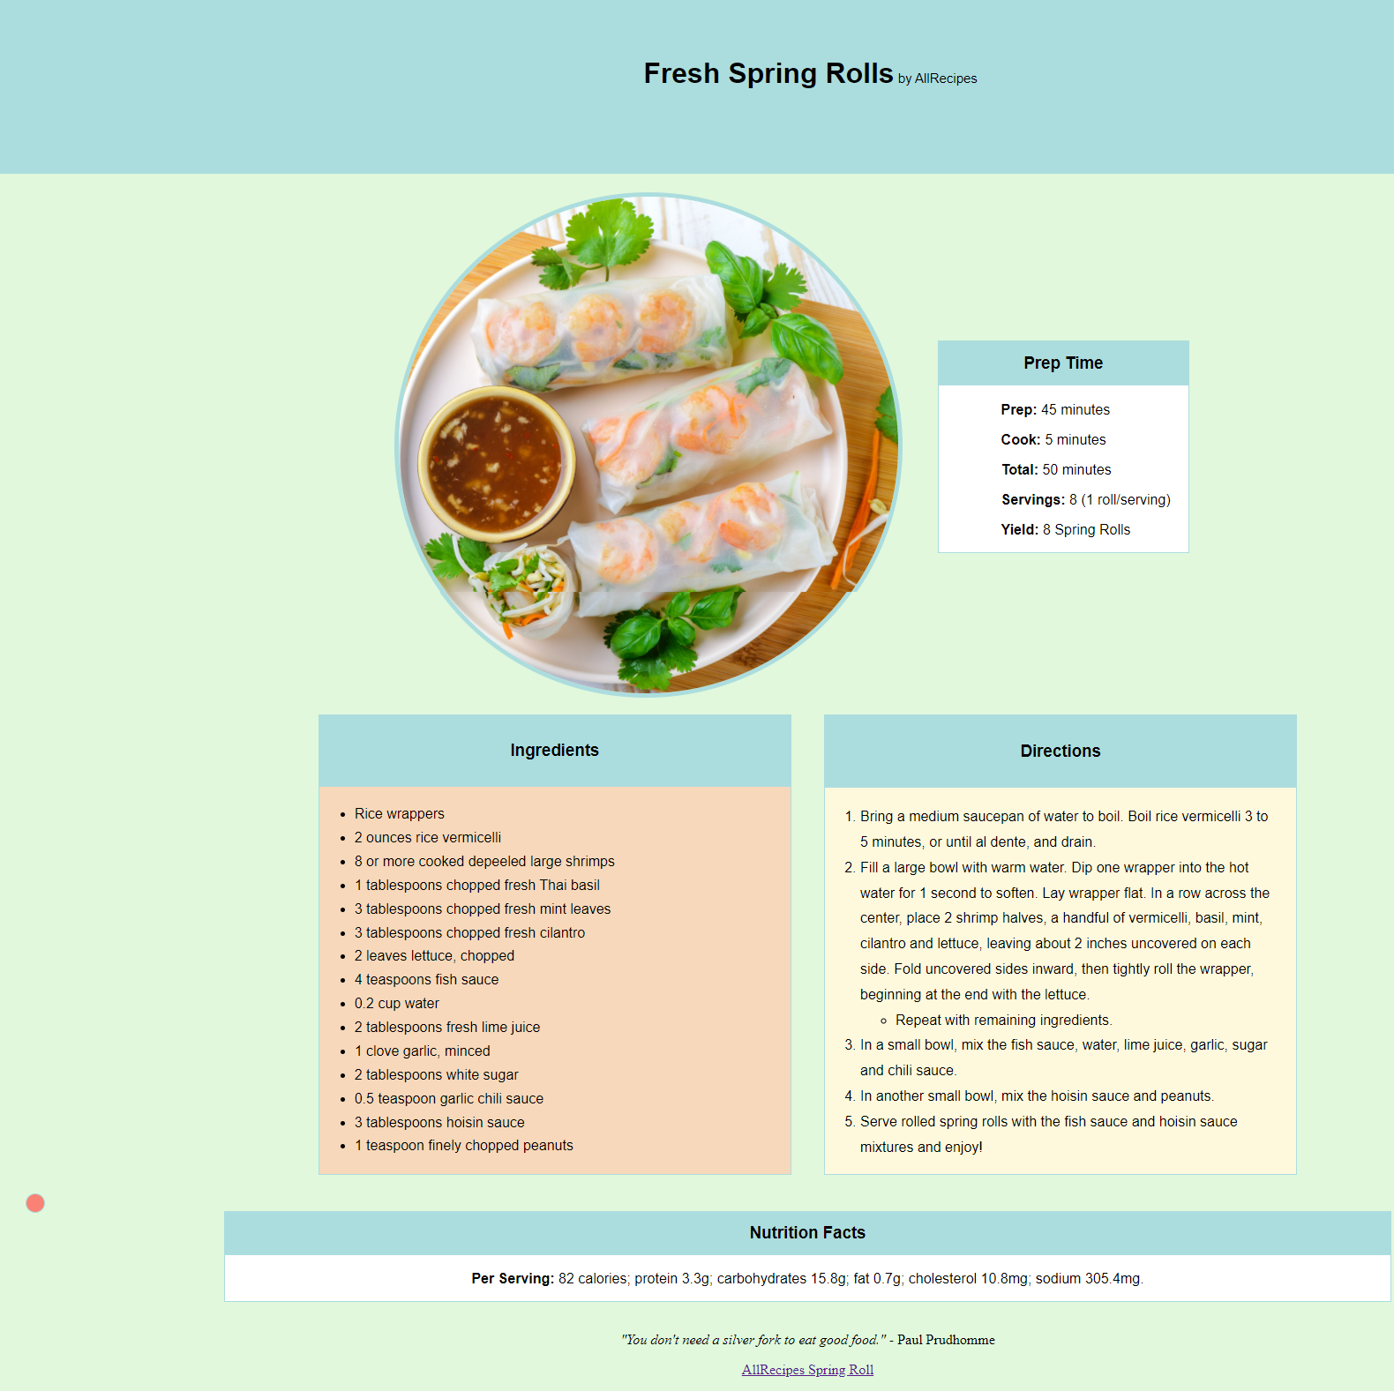
Design – Spring Roll Page
Color theme – light / pastel
Separate into sections given a header
Each Sections are wrapped in div

Slide 11
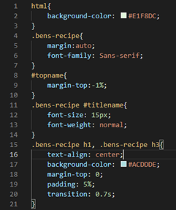
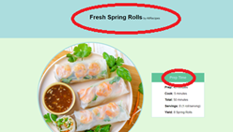
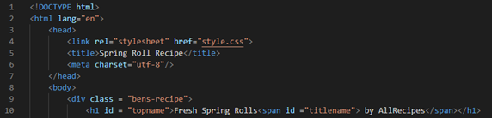
Head
•Reference .css file with link tag
•Title given as Spring Roll Recipe
•Header of page put inside div and named topname

Slide 12
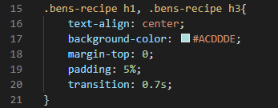
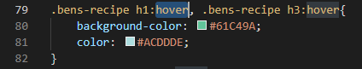
Transitions
Transitions properties are given to each of the headers
For each of the h1 and h3 in the HTML file,
A transition of BG color blue to green will occur
In 0.7s when the user hovers over the div

Slide 13
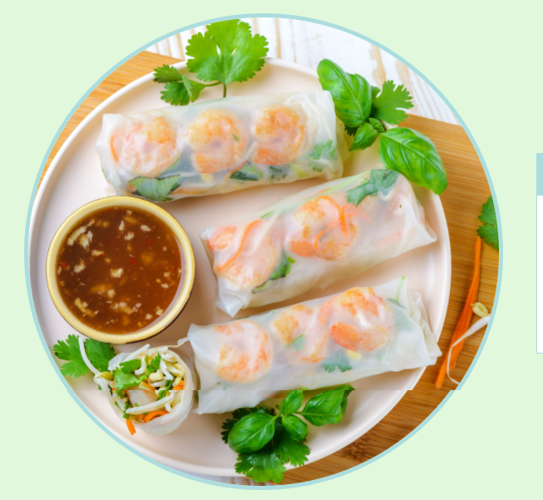
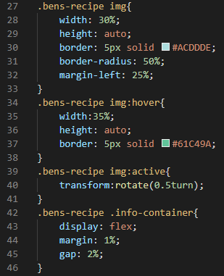
Image
Image placed in div called containerforpic
Tag img references image that is in same directory
CSS gives border and radius of border
Hover to enlarge image and click to rotate image

Slide 14
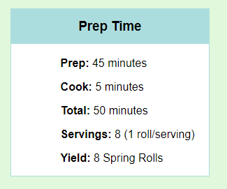
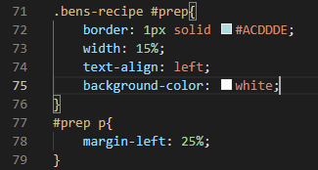
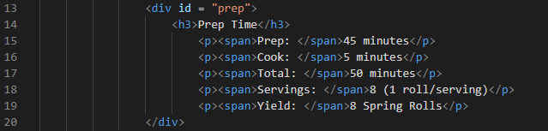
Prep Div
Prep div inside the flex display of containerforpic
Div given a border and width for aesthetics
Text inside is aligned to the left and then
Pushed to the middle with margin-left

Slide 15
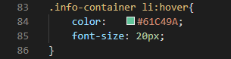
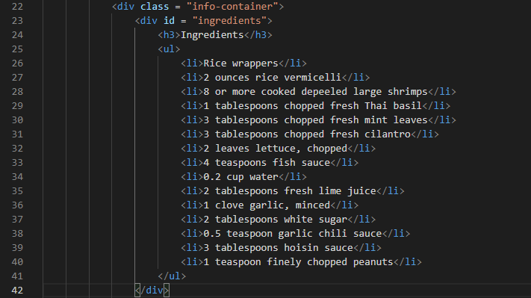
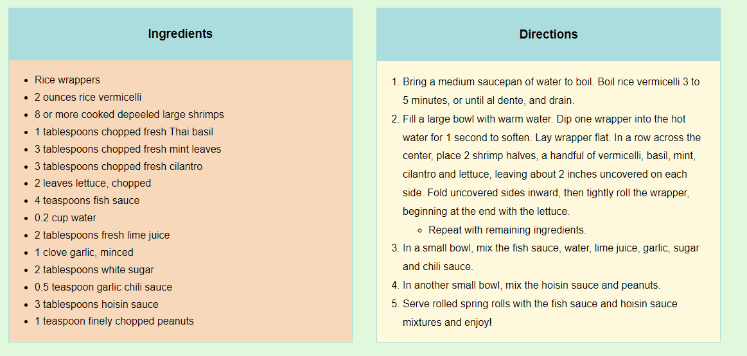
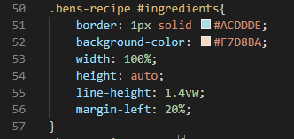
Ingredients div
Ingredient's tab placed into div with header and list
CSS will create a border and BG color
Container is flex display so
this element sits on the left of the div. Hover will
change the color of text in the list.

Slide 16
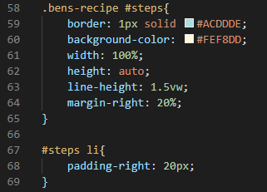
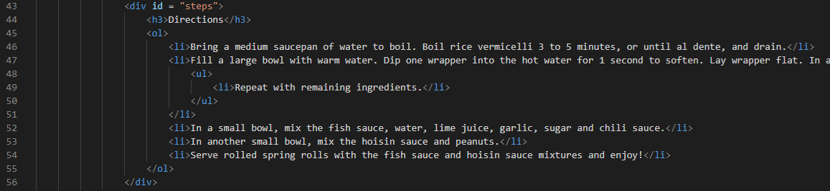
Directions div
This div contains similar tags and css as the
Previous div.
Padding-right is used to create space for the
Div aesthetics

Slide 17
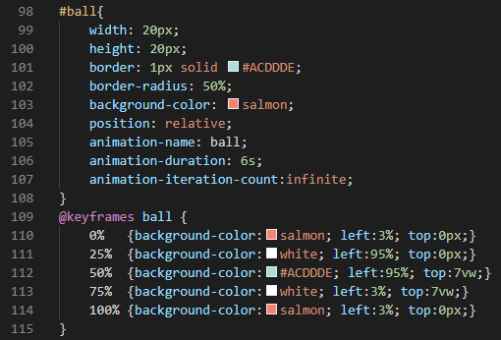

Ball div
Including the animations, a ball was created to move around the nutrition div (similar to prep div)
Ball was given size, border, and color
Animation properties were defined
Name, duration, iteration
@keyframes used to define the
Position and color of ball at different %

Slide 18
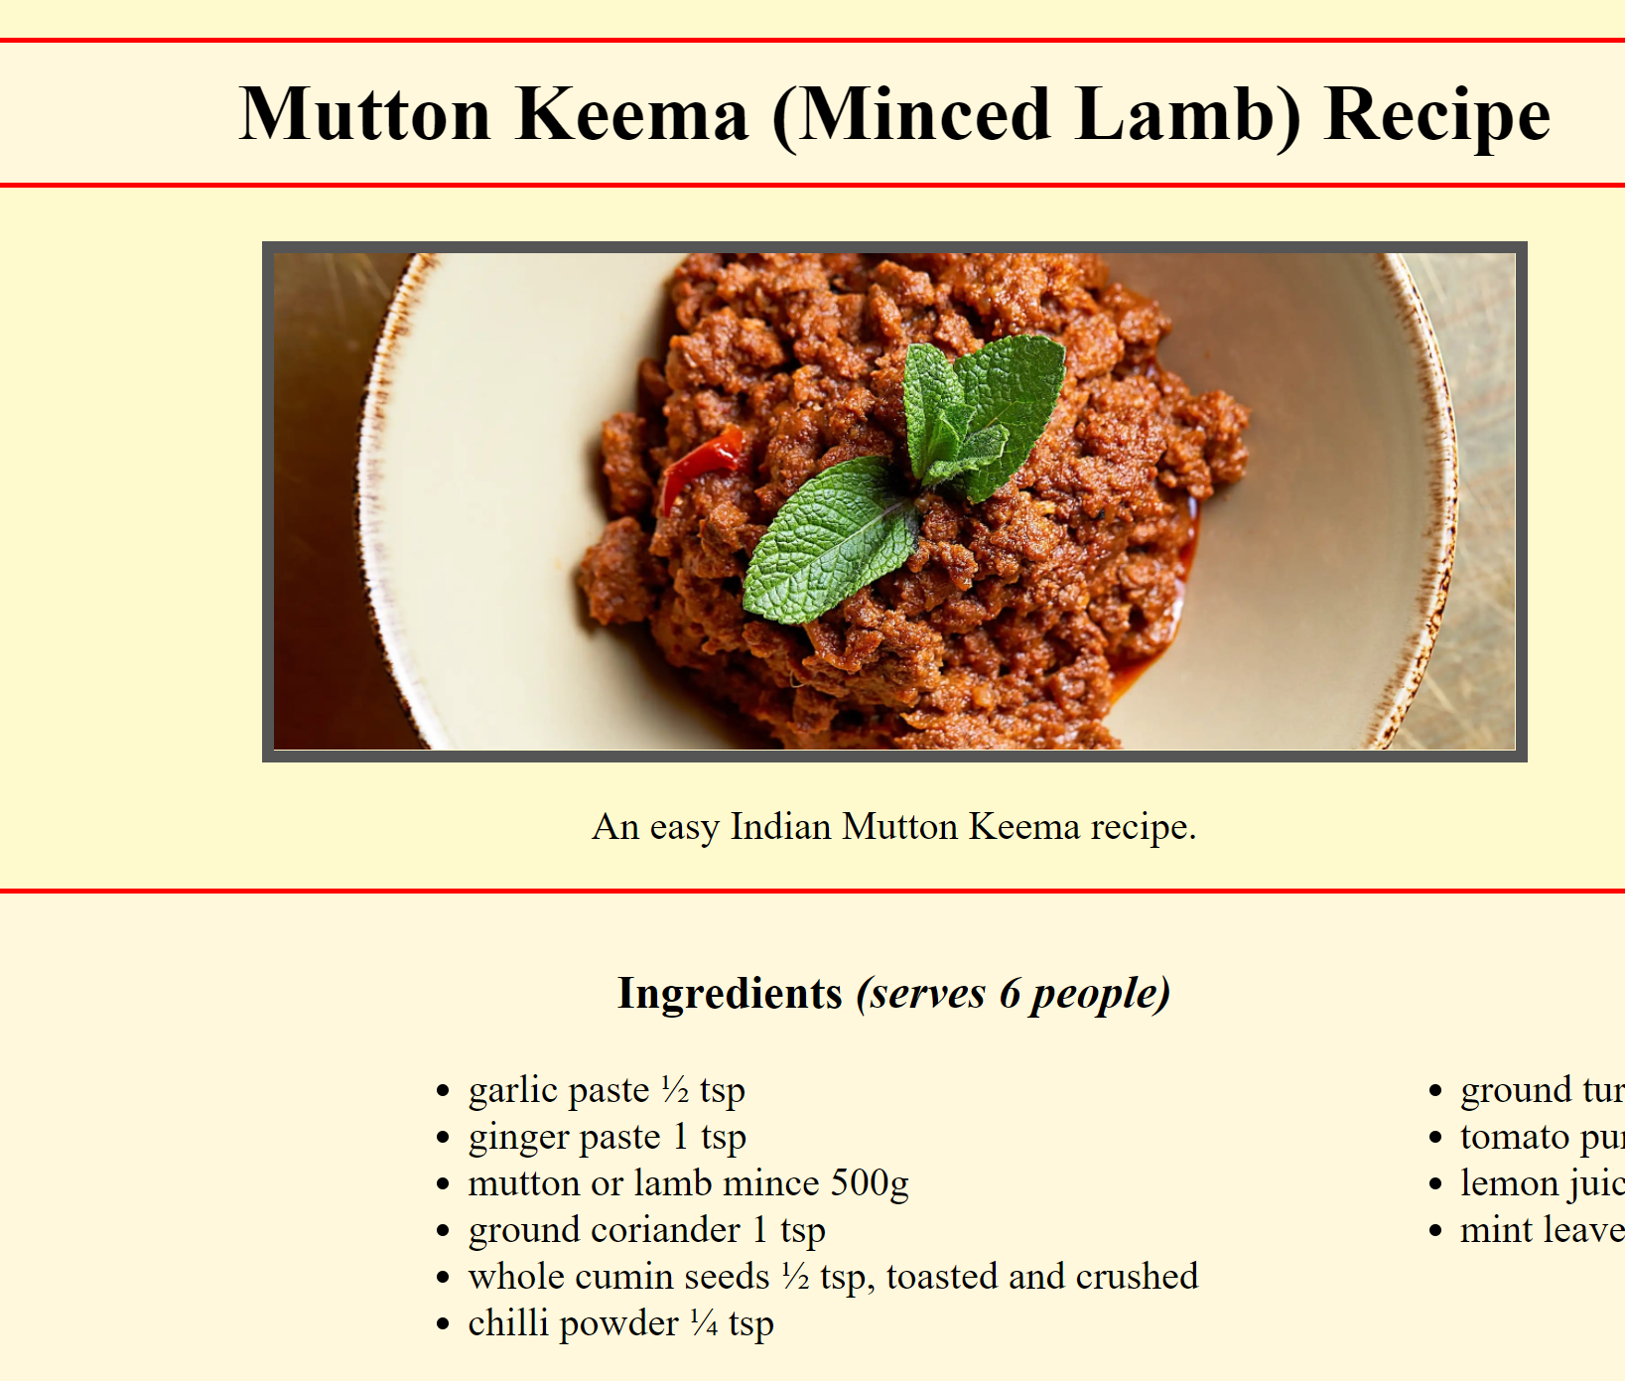
Design: Minced Keema Recipe
Primary background color: lemonchiffon
Secondary background color: fff8dc (very light yellow)
Image hover: 200% enlarge
Image border: 5 px solid #555 (dark grey)
3 columns for ingredients list
Unordered list for ingredients list; ordered list for steps

Slide 19
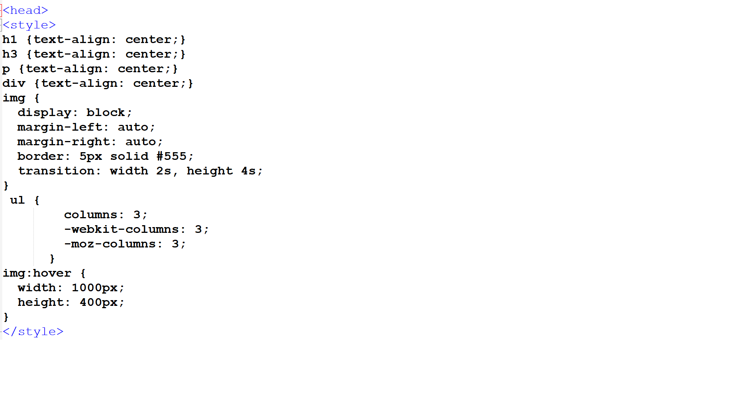
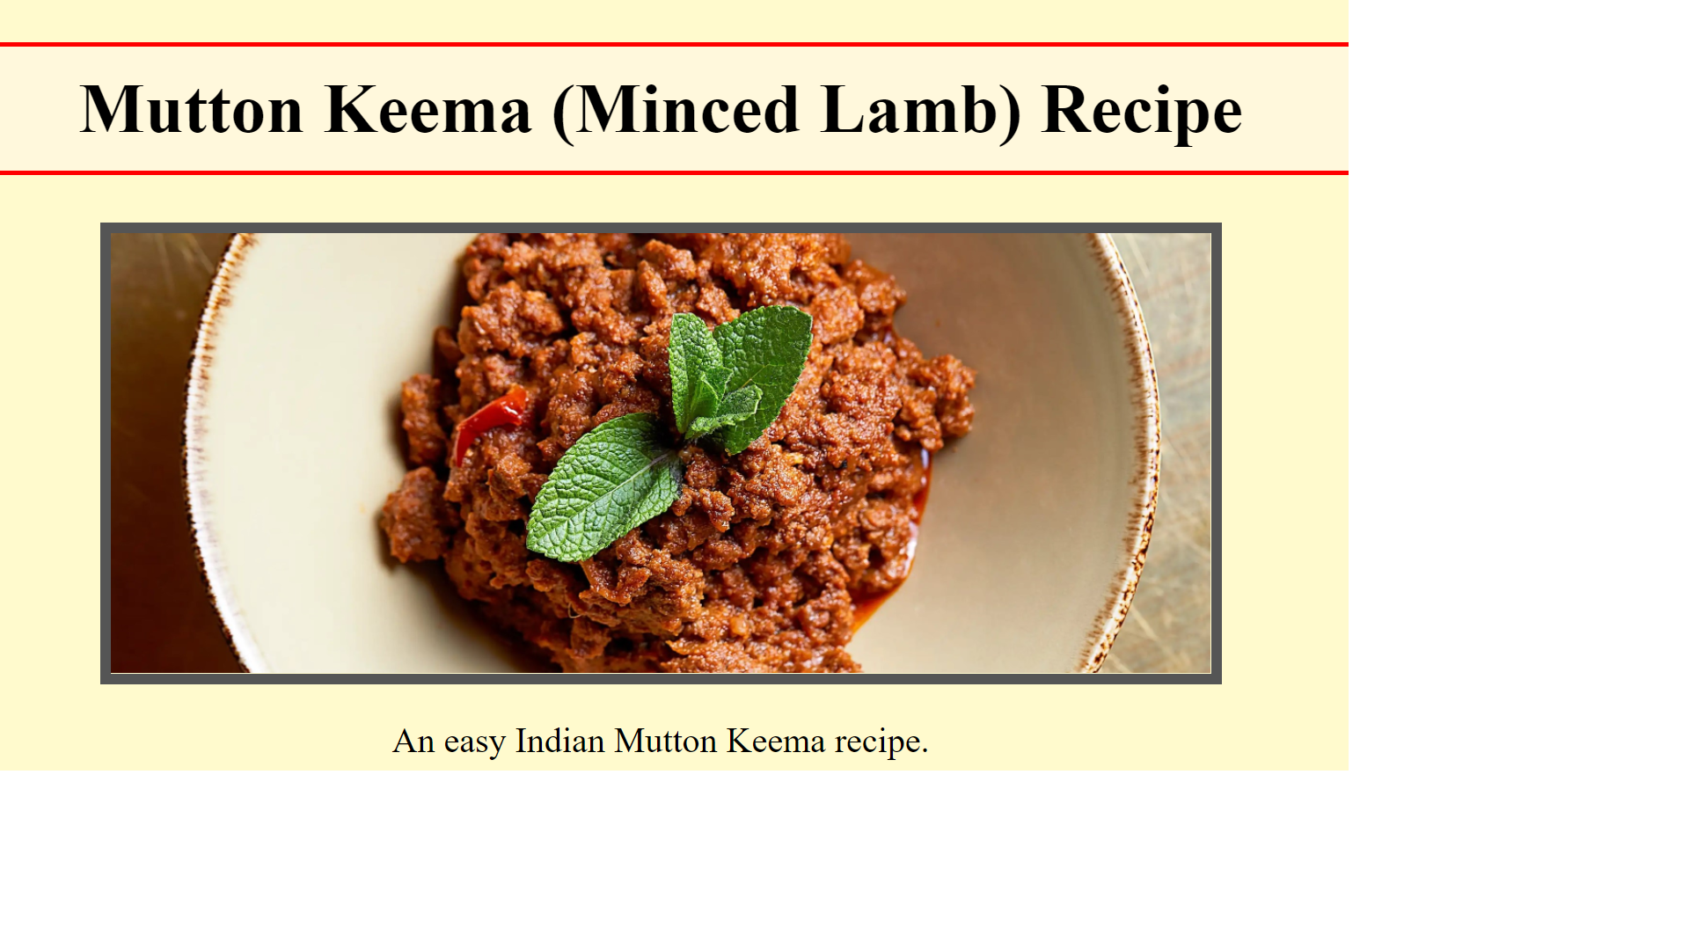
CSS and head style
Image aligned to center
Headers and titles aligned to center
Border added to image
Transition added to image: hovering over image enlarges it 200%

Slide 20
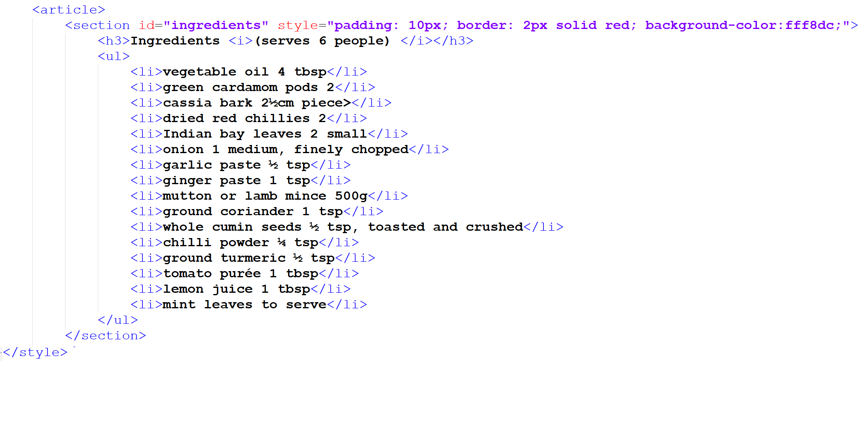
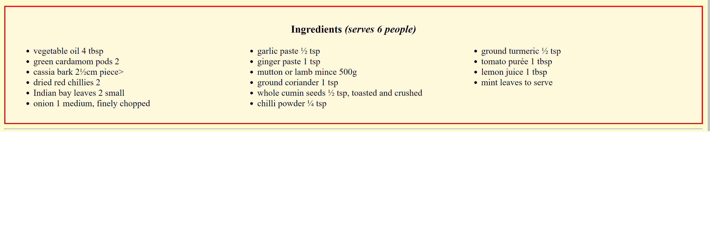
Ingredients section
Solid red border for the entire section
Unordered list for the ingredients list
Divided into 3 columns with the use of css
Line breaker in use after the section

Slide 21
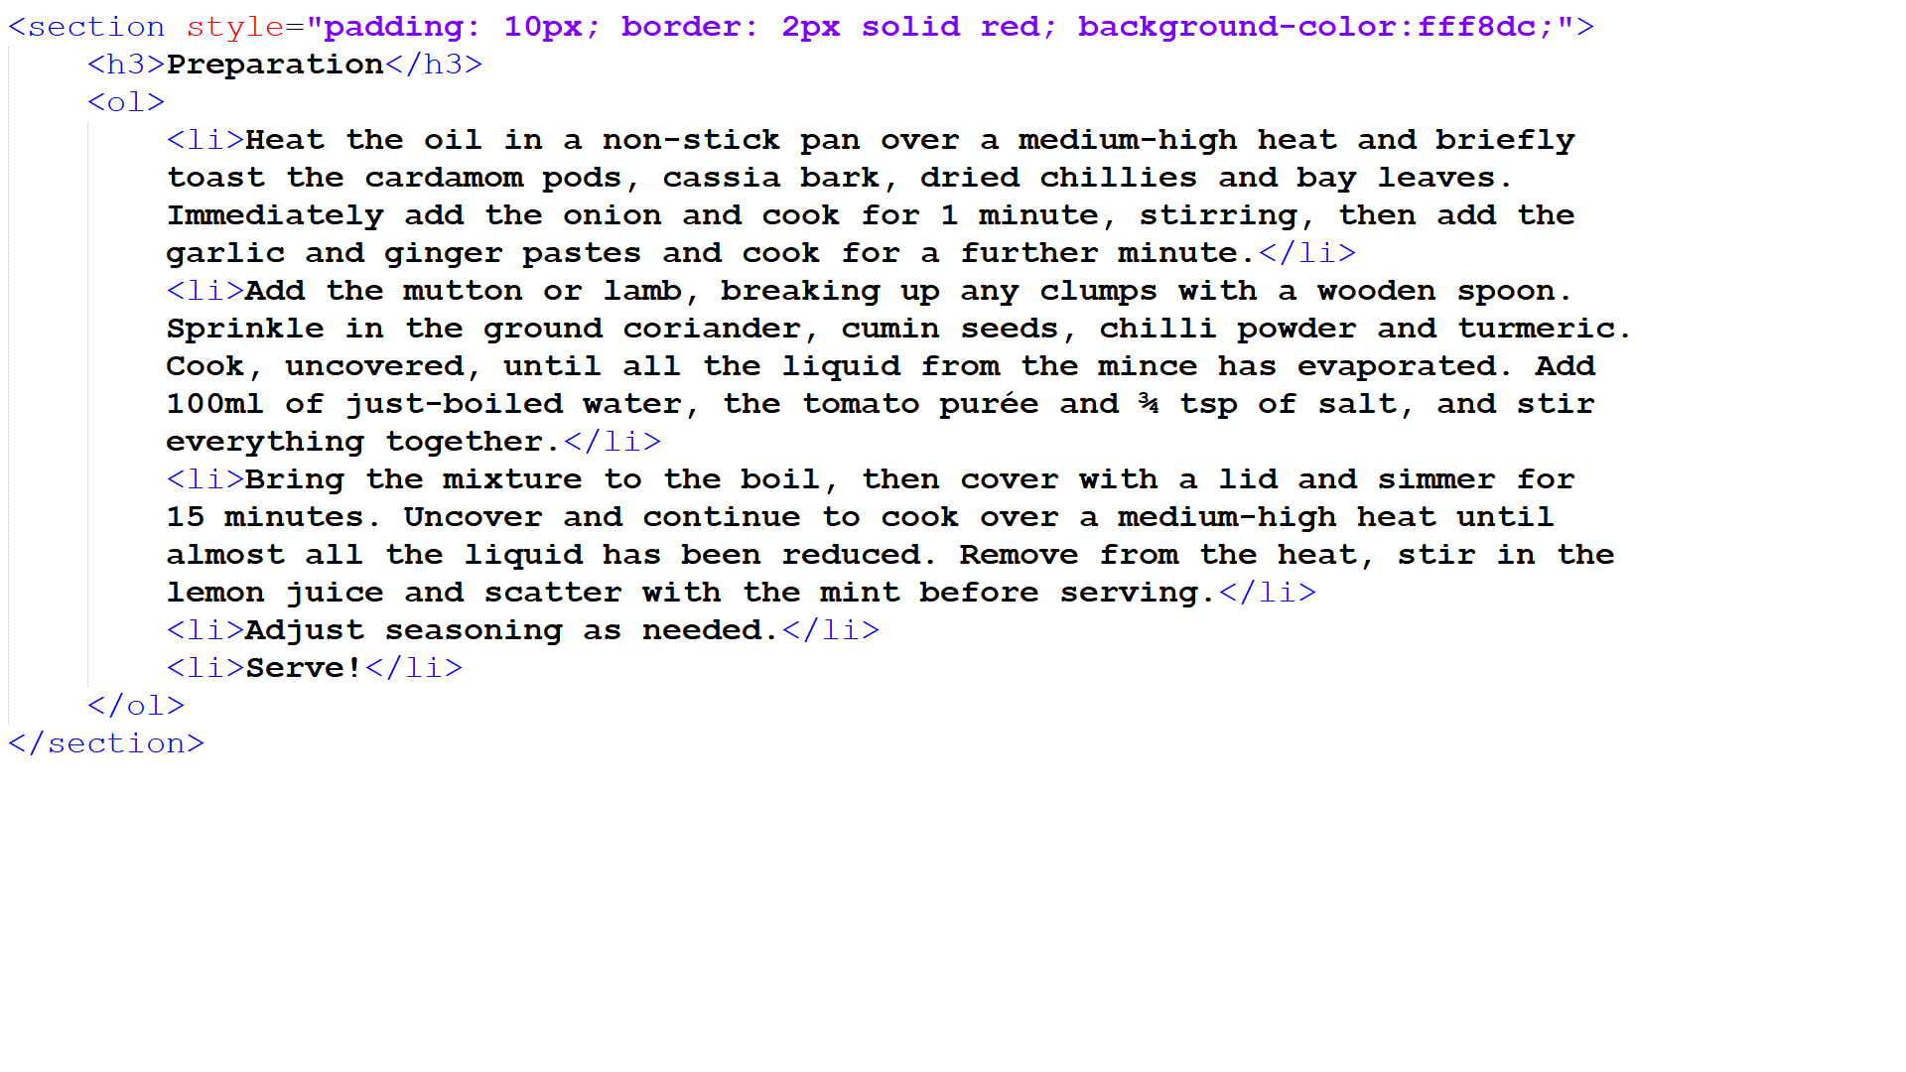
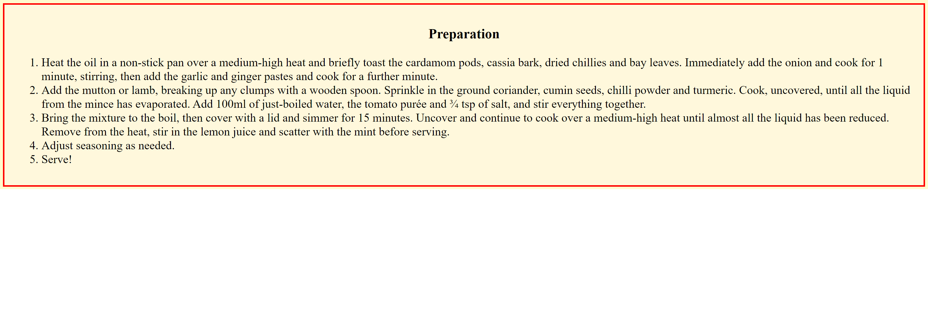
Preparation section
Ordered list used to show steps
Same dark red border used as the ingredients list

Slide 22
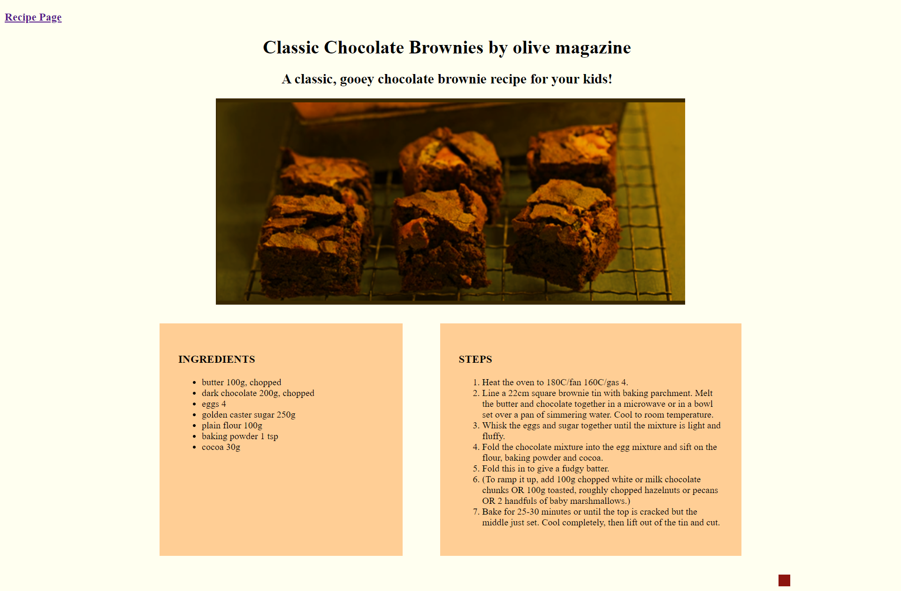
Design: Brownie Recipe
Main color theme: ivory, Maroon to match the picture. (hex: #ffce95)
Two div sections with header for steps and ingredients
Animation on the bottom with matching theme color with color transition
Everything centered

Slide 23
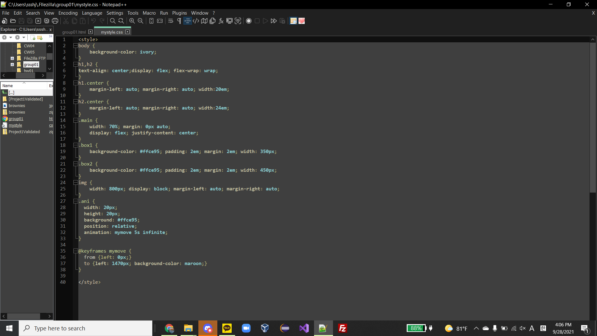
CSS, animation and header
Set background color and added animation of moving box from left end to right end with color transition from dark ivory to maroon, which is the matching color theme.

Slide 24
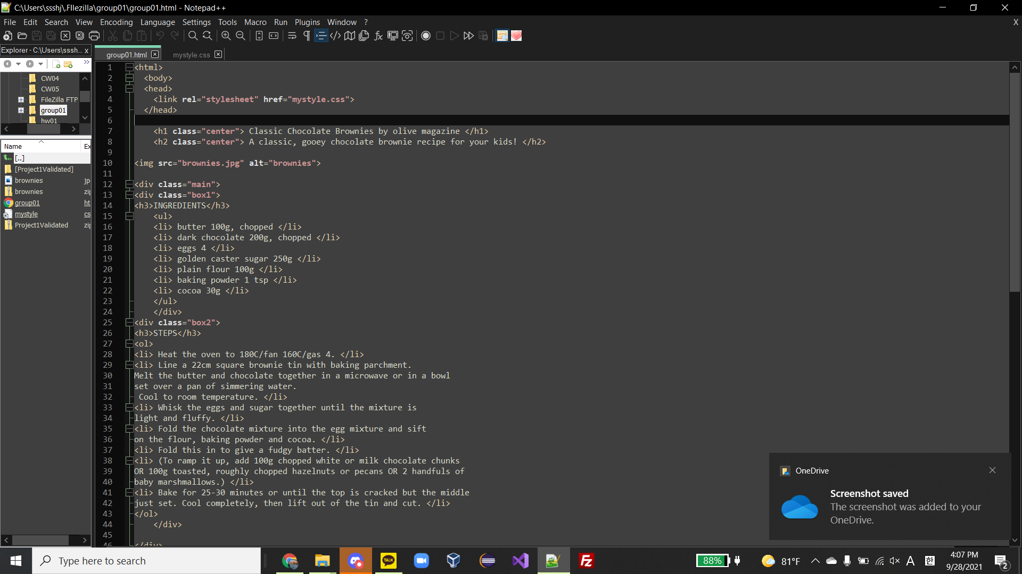
Ingredients div section
Used div to make a block and added header
Unordered list for ingredients
Hex ffce95 for the background color, no border

Slide 25
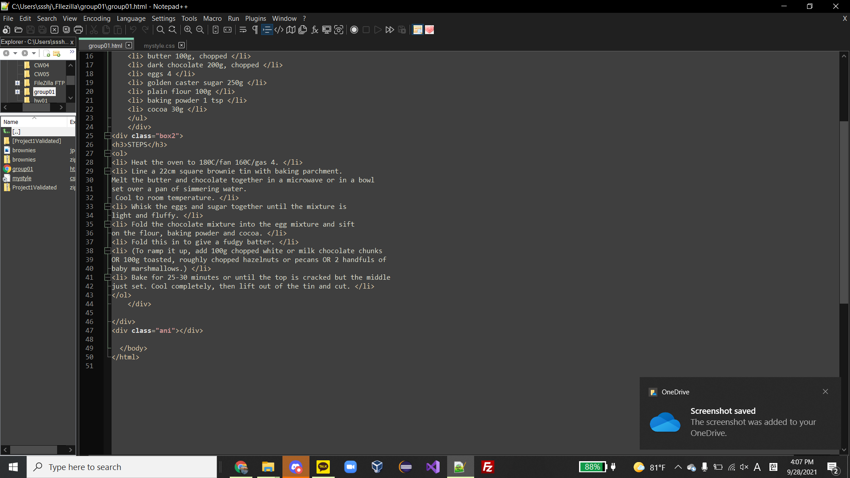
Steps div section
Used div to make a block and added header
Ordered list with numbers for the steps
Identical background color with ingredients div section

